Slide 1
Infix to Prefix Expression

Slide 2
Method1- Algorithm Infix to Prefix Expression
Step 1. Push “)” onto STACK, and add “(“ to start of the A.
Step 2. Scan A from right to left and repeat step 3 to 6 for each element of A until the STACK is empty or contain only “)”
Step 3. If an operand is encountered add it to B
Step 4. If a right parenthesis is encountered push it onto STACK
Step 5. If an operator is encountered then:
a. Repeatedly pop from STACK and add to B each operator (on the top of STACK) which has higher precedence than the operator.
b. Add operator to STACK
Step 6. If left parenthesis is encountered then
a. Repeatedly pop from the STACK and add to B (each operator on top of stack until a right parenthesis is encountered)
b. Remove the left parenthesis
Step 7. Reverse B to get prefix form

Slide 3
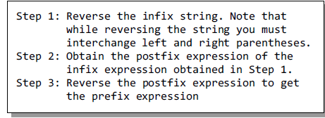
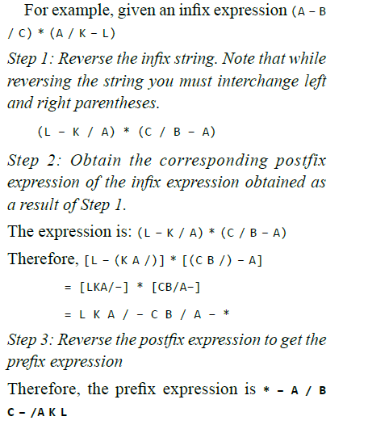
Method2- Infix Expression to a Prefix Expression

Slide 4
Step 1. Push “)” onto STACK, and add “(“ to start of the A.
Step 2. Scan A from right to left and repeat step 3 to 6 for each element of A until the STACK is empty or contain only “)”
Step 3. If an operand is encountered add it to B
Step 4. If a right parenthesis is encountered push it onto STACK
Step 5. If an operator is encountered then:
a. Repeatedly pop from STACK and add to B each operator (on the top of STACK) which has higher precedence than the operator.
b. Add operator to STACK
Step 6. If left parenthesis is encountered then
a. Repeatedly pop from the STACK and add to B (each operator on top of stack until a right parenthesis is encountered)
b. Remove the left parenthesis
Step 7. Reverse B to get prefix form
14 / 7 * 3 – 4 + 9 / 2
Char | Stack | Expression

Slide 5
14 / 7 * 3 – 4 + 9 / 2
Char | Stack | Expression

Slide 6
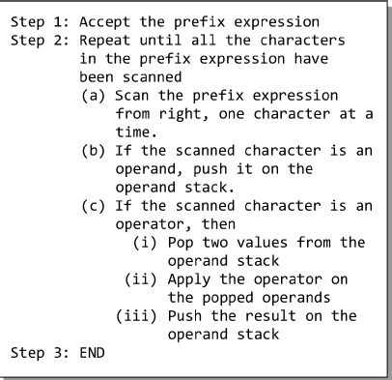
Evaluation of a Prefix Expression

Slide 7
14 / 7 * 3 – 4 + 9 / 2 + - * / 14 7 3 4 / 9 2
Char | Stack | Expression

